Slide 1


Uber Trip Analysis
By:
Niket Talikoti

Slide 2
Project Summary
This project aimed to analyze and forecast Uber trip demand using real-world data from New York City in early 2015. By leveraging historical trip patterns and operational features, we sought to develop predictive models that could inform Uber's strategic decisions. The analysis covered a two-month period, providing a solid foundation for understanding short-term demand fluctuations.
Objective
Duration
Tools Used
Analyze and forecast Uber trip demand using real-world 2015 NYC data.
January–February 2015
Python (Pandas, Scikit-learn, XGBoost)
Plotly for interactive visuals
Jupyter Notebook

Slide 3

Problem Statement
Uber, like any on-demand service, faces the critical challenge of balancing supply and demand to ensure efficiency and customer satisfaction. Predicting daily trip volume is paramount for optimal fleet allocation, driver scheduling, and overall operational smoothness. This project directly addresses how machine learning can provide actionable insights to meet these challenges.
Business Challenge
Goals
How can Uber predict daily trip demand based on historical data and operational features to enhance service efficiency?
Analyze temporal and base-level patterns
Predict trip volume using ML models
Make data-driven operational decisions

Slide 4

Dataset Overview
The analysis was conducted on a comprehensive dataset of Uber trips within New York City, spanning the first two months of 2015. This dataset provides crucial information including the date of the trip, the dispatch center (base number), the total number of trips, and the count of active vehicles. Understanding these key columns was fundamental to identifying patterns and building accurate predictive models.
Source
Uber NYC Jan-Feb 2015
Key Columns
Date
Base Number (dispatch center)
Trips (total rides)
Active Vehicles
Time Range
1 Jan 2015 – 28 Feb 2015

Slide 5
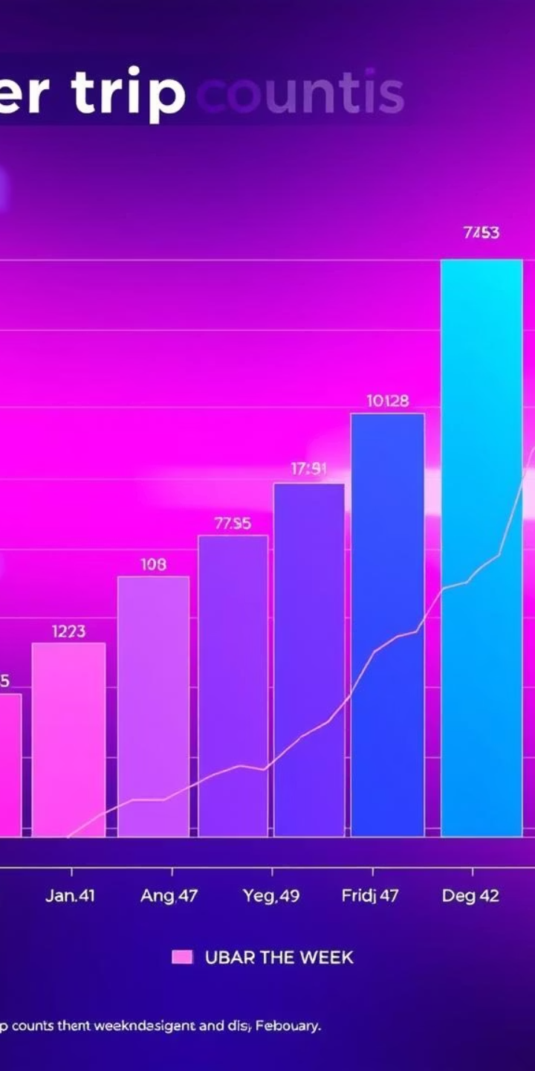



Exploratory Data Analysis (EDA)
Our Exploratory Data Analysis revealed compelling insights into Uber trip patterns. We observed a clear trend of highest demand on Fridays, gradually decreasing to the lowest on Sundays, suggesting weekday commuting and weekend leisure impacts. The overall trip volume showed a steady rise through mid-January, indicating growing adoption or specific events, with noticeable dips on weekends. Furthermore, certain dispatch centers consistently handled significantly more traffic, pointing to key operational hubs.
Trip Distribution by Weekday
Insight: Highest demand on Fridays, lowest on Sundays.
Trip Trend Over Time
Insight: A steady rise in trips mid-January, possible dips on weekends.
Base-wise Activity
Insight: Certain bases consistently handle more traffic.

Slide 6
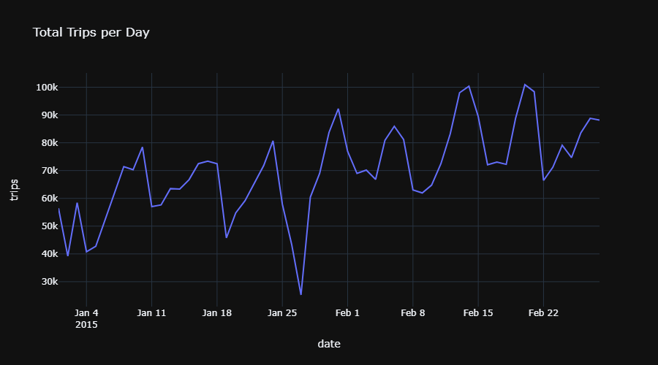
Total Trips per Day
In early 2015, Uber trip data shows post-New Year dips and weekday-weekend patterns emerging mid-January. A sharp drop around January 26–27 likely points to an external event. By February, the platform gains momentum—daily rides consistently exceed 90,000, even hitting 100,000+. This growth signals rising demand, user adoption, and platform maturity. Weekly cycles remain visible, reflecting consistent commuting and weekend activity. Uber’s rapid rise highlights its role as a key urban mobility solution.

Slide 7
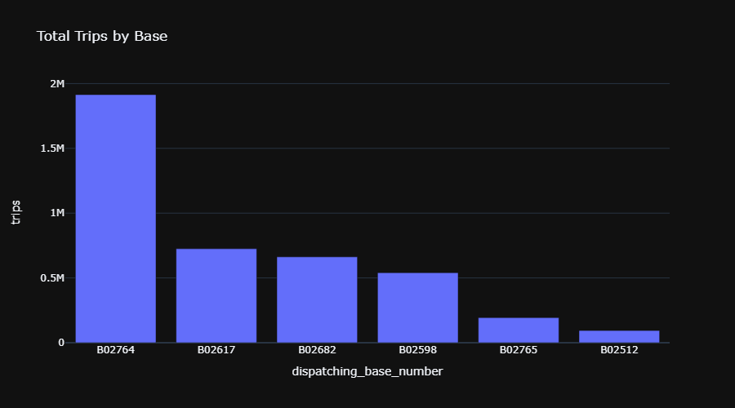
Total Trips by Base
Uber’s dispatch data in early 2015 shows B02764 as the dominant hub with nearly 2 million trips—clearly the operational core. Mid-tier bases like B02617 and B02682 contribute strong support with 600k–750k trips. Lower-volume bases such as B02765 and B02512 indicate smaller regions or developing zones. The distribution follows a power-law trend—few bases handle most of the demand, while others serve niche or growing areas, revealing how Uber's network clusters around key operational points.

Slide 8
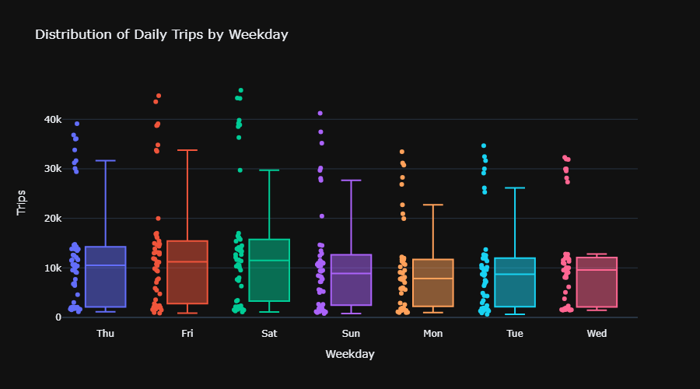
Daily Trips by Weekday
Uber ride data reveals clear weekly patterns. Friday leads with the highest and most variable trip counts, driven by commuting and social outings. Thursday and Saturday also show strong, diverse usage, blending work and leisure. In contrast, Monday to Wednesday are steadier, with lower, more routine volumes. Sunday mirrors Saturday’s variability but at slightly reduced levels. Overall, ride patterns reflect city life—structured weekdays, lively weekends, and shifting rhythms shaped by human routines and urban dynamics.

Slide 9
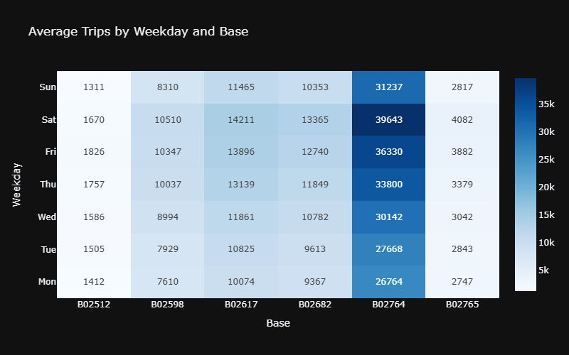
Average Trips by Weekday and Base
Uber’s heatmap reveals B02764 as the top-performing base, peaking at ~40,000 trips on Saturdays and dominating every weekday. Bases like B02617 and B02682 show rising weekend activity, reflecting commuter and social trends. In contrast, B02512 and B02765 remain low and steady, likely serving quieter areas. Mondays are the slowest overall. The chart uncovers both time-based and location-based demand, offering key insights for optimizing Uber’s driver distribution and aligning with the city’s shifting rhythms.

Slide 10
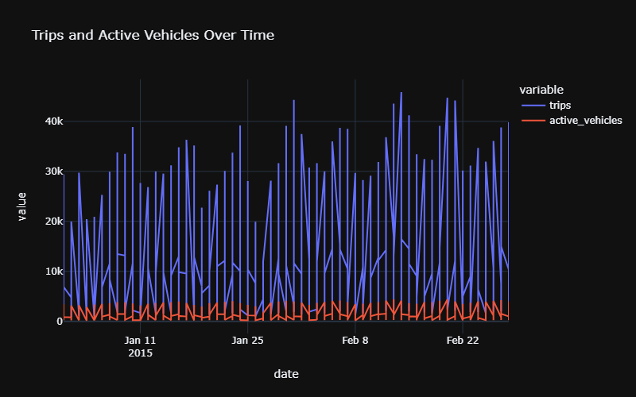
Trips and Active Vehicles Over Time
Uber’s timeline reveals a clear correlation between the number of active vehicles and the completion of trips. As the number of drivers increases, especially on weekends, trip volumes rise in tandem. This trend highlights Uber’s ability to effectively match supply with demand. The pattern remains consistent across the two months, proving the strength of its operational strategy. In short, more vehicles mean more rides, reinforcing the need for a scalable and responsive fleet to maintain service quality and meet user demand.

Slide 11
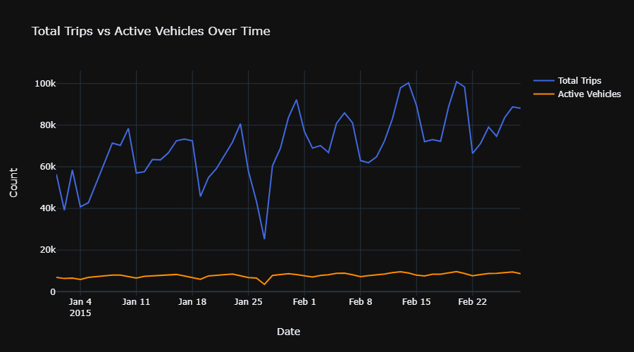
Total Trips vs Active Vehicles Over Time
From January to February 2015, total trips show clear weekly peaks—likely weekends—highlighting strong demand cycles. However, active vehicle counts remain steady with little variation. This imbalance suggests that supply isn’t adjusting to meet demand spikes, pointing to a missed optimization opportunity. A significant dip in trips around January 25 may reflect an anomaly. Overall, dynamic vehicle allocation based on demand trends could improve efficiency and better serve rider needs.

Slide 12
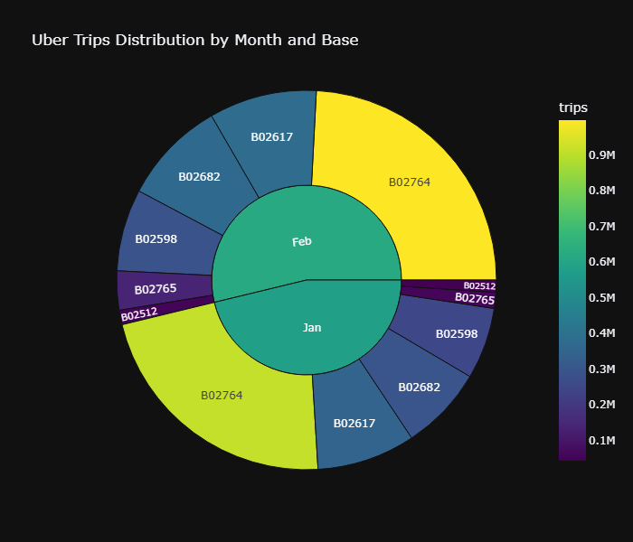
Uber Trips Distribution by Month and Base
The sunburst chart reveals Base B02764 as the top performer in both January and February, with a notable trip increase in February, pointing to rising demand. Mid-tier bases like B02617, B02682, and B02598 show stable, moderate contributions. In contrast, B02512 and B02765 consistently report low volumes, possibly indicating underutilized zones. Overall, February sees more trips than January, suggesting platform growth. These insights can guide strategic resource allocation and help evaluate performance gaps across different base regions.

Slide 13
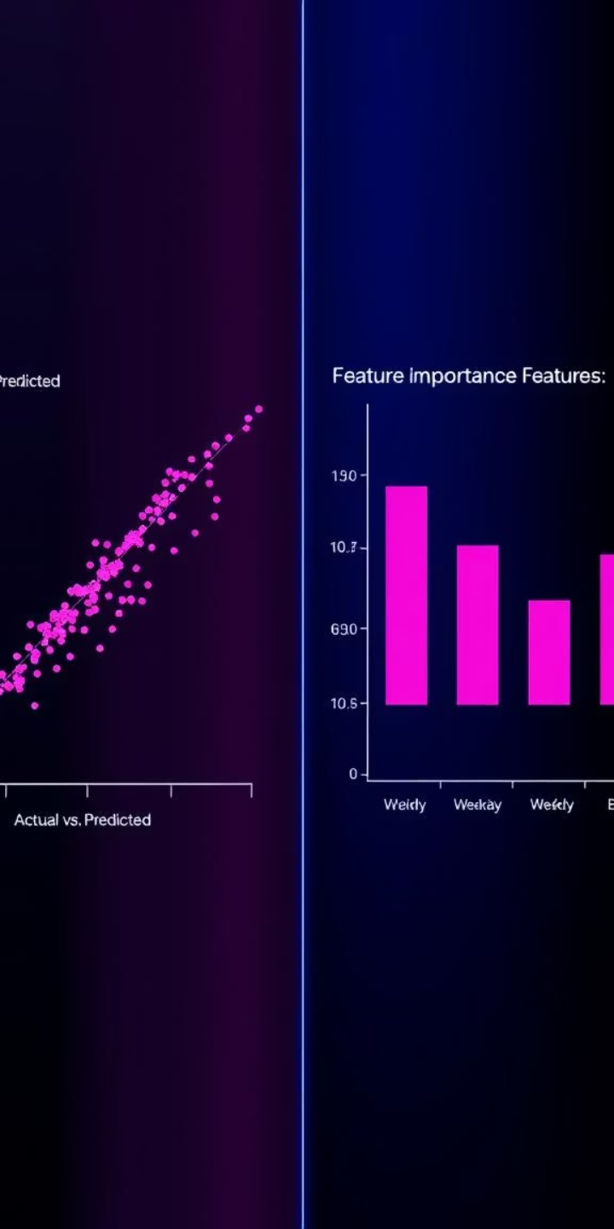
Machine Learning Modeling
To predict trip demand, we employed a robust machine learning approach, beginning with essential feature engineering. We extracted temporal features such as Day, Month, and Weekday, and incorporated the 'Base' dispatch center information, to capture diverse patterns. The Random Forest Regressor model was selected for its ability to handle complex relationships and provide reliable predictions. Its performance was rigorously evaluated using industry-standard metrics to ensure accuracy and applicability.
1
Feature Engineering
Created new features like Day, Month, Base, and Weekday from the raw data.
2
Model Selection
Implemented Random Forest Regressor for its predictive power.
3
Performance Metrics
Evaluated using RMSE, R², and MAPE for comprehensive assessment.

Slide 14




Time Series Forecasting
Beyond static predictions, understanding the temporal evolution of demand is crucial for operational planning. We utilized the XGBoost Regressor, a powerful gradient boosting framework, specifically for time series forecasting. This model effectively captured the inherent weekday seasonality and overall growth trends observed in the Uber trip data. By integrating time as a critical factor, we were able to generate forecasts for future days, enabling proactive resource management.
XGBoost Regressor
Selected for its strength in handling temporal data and complex patterns.
Forecasting Goal
To accurately predict future daily trip volumes based on historical trends.
Insights Captured
Successfully identified weekday seasonality and underlying growth trends in demand.

Slide 15
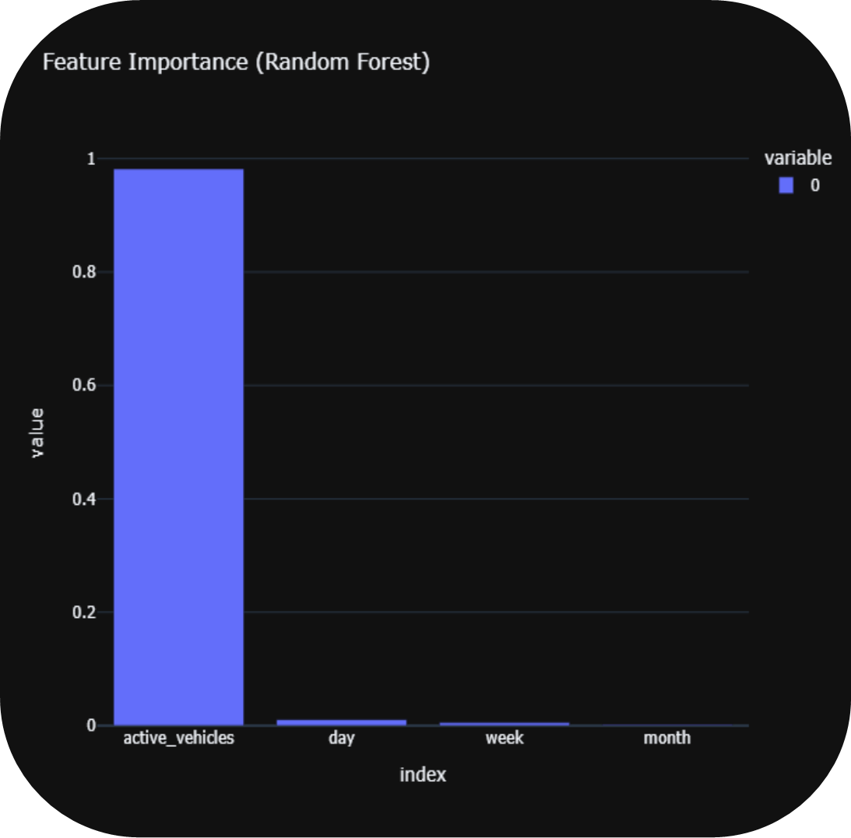
Feature Importance (Random Forest)
The Random Forest model reveals that active vehicles alone drive nearly 100% of Uber trip volume prediction, far outweighing time-based features like day, week, or month. This underscores that real-time driver availability is the key factor in trip completion. Time variables contribute minimally, highlighting that operational efficiency, not seasonal trends, determines success. In short, mobilizing more drivers directly translates to more trips, making fleet optimization Uber’s most powerful lever for performance improvement.

Slide 16
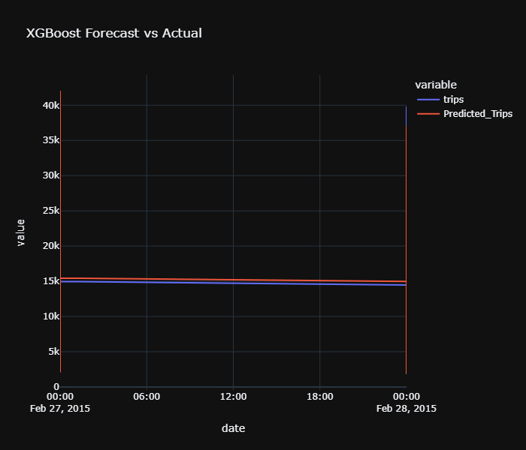
XGBoost Forecast vs Actual
The XGBoost model closely tracks actual trip volumes on February 27, 2015, showing strong short-term forecasting ability. Most predictions align around 15,000 trips, indicating the model captures core patterns well. However, a sharp over-prediction occurs at the transition to February 28, diverging from actual data. This spike suggests a possible anomaly, outlier, or model limitation. While reliable under stable conditions, the model may struggle with sudden shifts—highlighting the need for further validation and refinement.

Slide 17
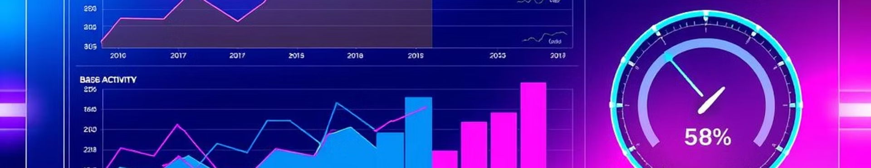




Key Takeaways
Our analysis yielded several critical insights that can significantly impact Uber's operational strategies. The consistent demand peaks on weekdays, especially Fridays, highlight prime opportunities for surge pricing or increased driver incentives. The dominance of certain base centers indicates areas where infrastructure or resource allocation might need special attention. Importantly, our machine learning models demonstrated high performance, ensuring the reliability of predictions.
Demand peaks on weekdays (esp. Friday)
Certain base centers dominate trip handling
ML models perform well with RMSE < threshold
Time series forecasting adds value for daily planning

Slide 18
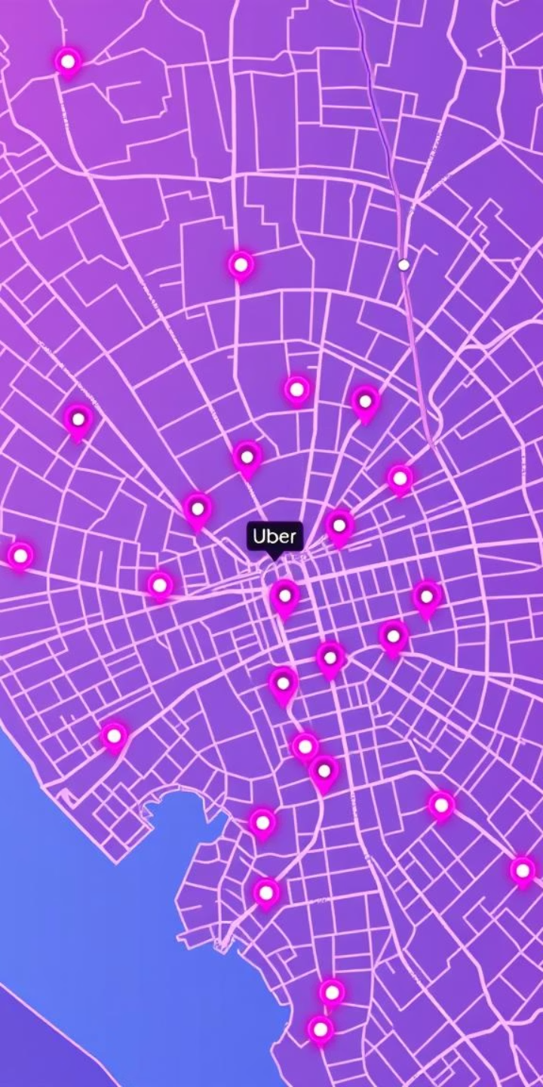
Business Implications
The insights derived from this analysis have tangible business implications, offering Uber concrete strategies to enhance its service delivery and operational efficiency. By accurately forecasting demand, Uber can optimize fleet allocation to high-demand areas, minimize passenger wait times, and make informed scheduling decisions for drivers. This data-driven approach supports overall resource optimization, leading to improved profitability and a superior customer experience.
Better fleet allocation
Optimize car distribution to match demand hotspots.
Lower wait times
Improve customer satisfaction through quicker service.
Informed scheduling decisions
Strategically align driver availability with peak hours.
Supports resource optimization
Maximize efficiency across all operational aspects.

Slide 19

Thank You / Q&A
Thank you for your time and attention. I am now open to any questions you may have regarding this Uber Trip Analysis and Forecasting project. Please feel free to connect or explore my other work via the links below.
🔗 linkedin.com/in/nikettalikoti
🐙 github.com/niketgtalikoti

